Slide 1
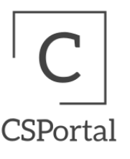
Final Presentation
Iteration 5
Computer Science Project Portal

Slide 2
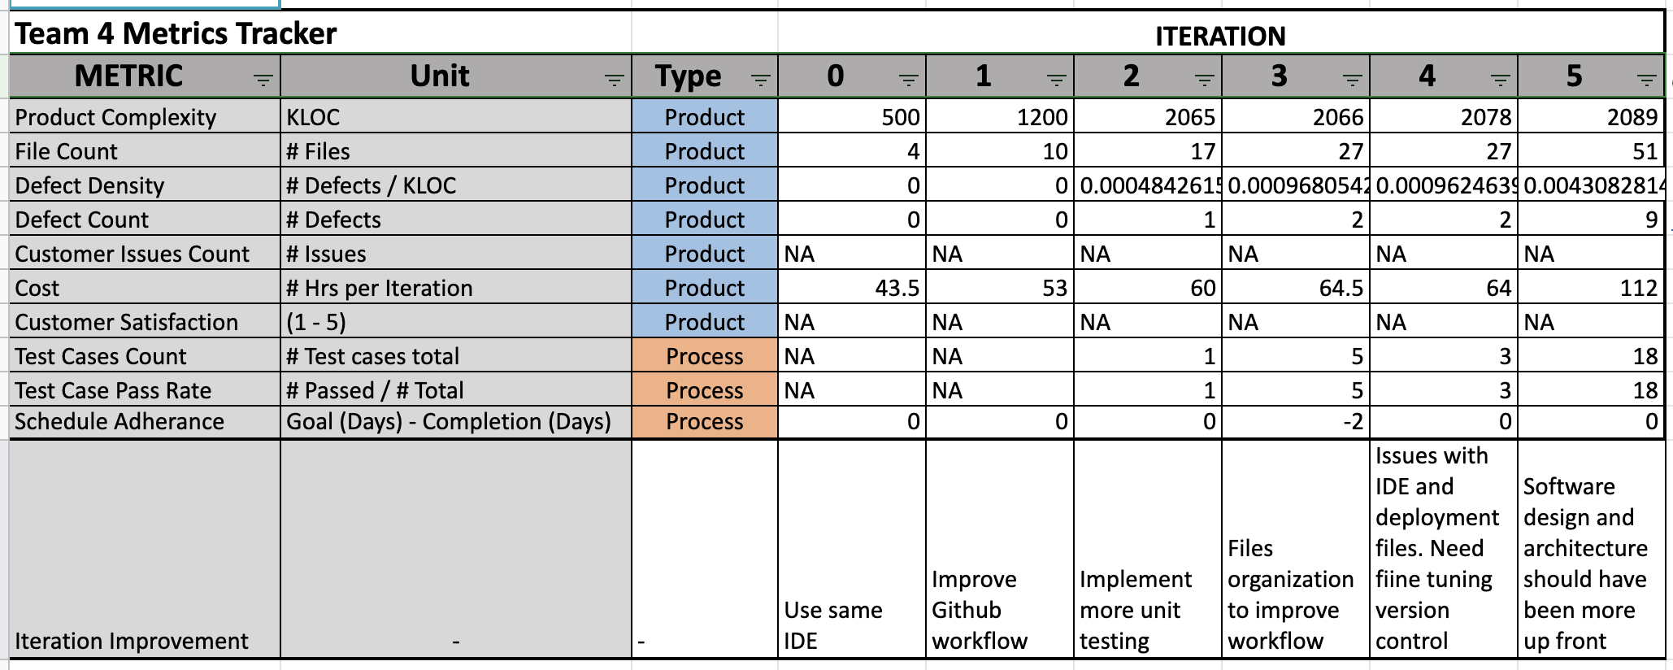
Metrics

Slide 3
Requirements Analysis
Requirement | Priority Level | Status
Add Project | Essential Feature | Implemented
Search Projects | Essential Feature | Implemented
Create Account + Login/out | Essential Feature | Implemented
Comment on Projects | Desirable Feature | Implemented
Edit Project Info | Desirable Feature | Implemented
Delete Project | Desirable Feature | Implemented
Upload Files to Projects | Desirable Feature | Unfinished
Contact Project Author | Optional Feature | Not Implemented

Slide 4
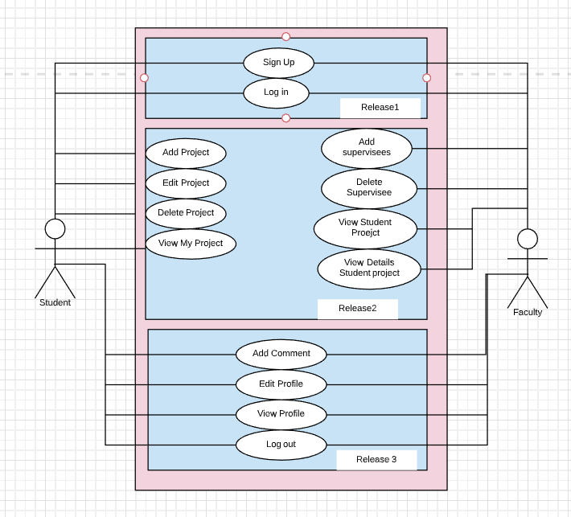
Use Case Diagram
Requirements evolved as project developed
All requirements tracking done in google docs and updated after team meetings
Consistently updating user stories to align with updated requirements with pivotal tracker
18 user stories completed out of ~25 found in pivotal tracker
Login/out
Search Projects

Slide 5
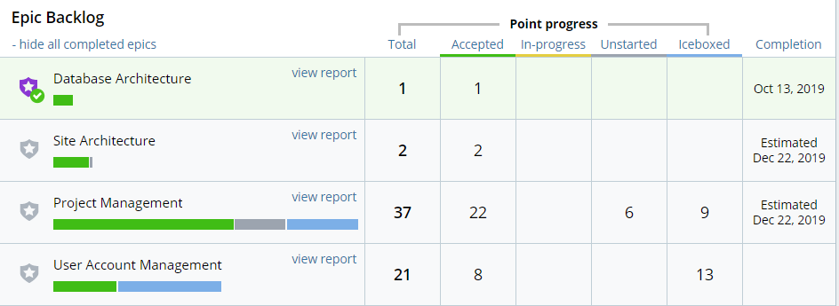
Pivotal Tracker Report

Slide 6
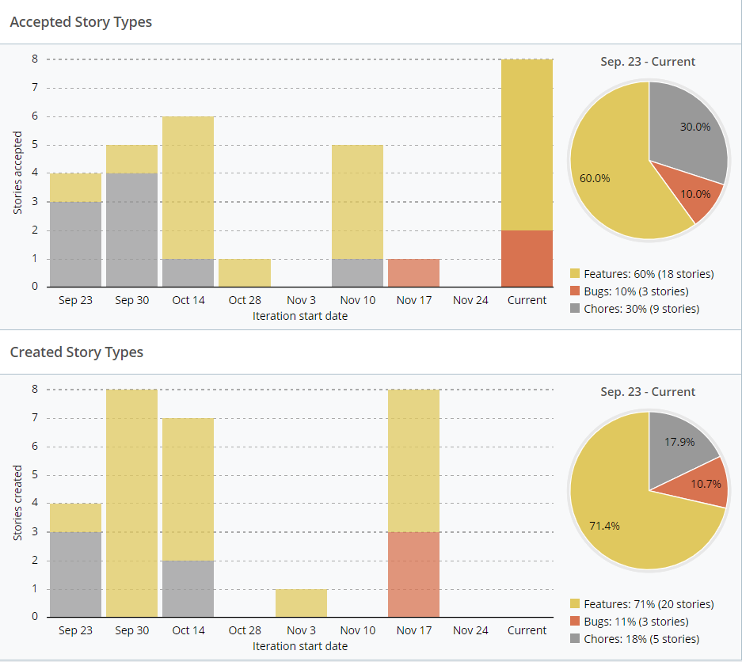

Slide 7
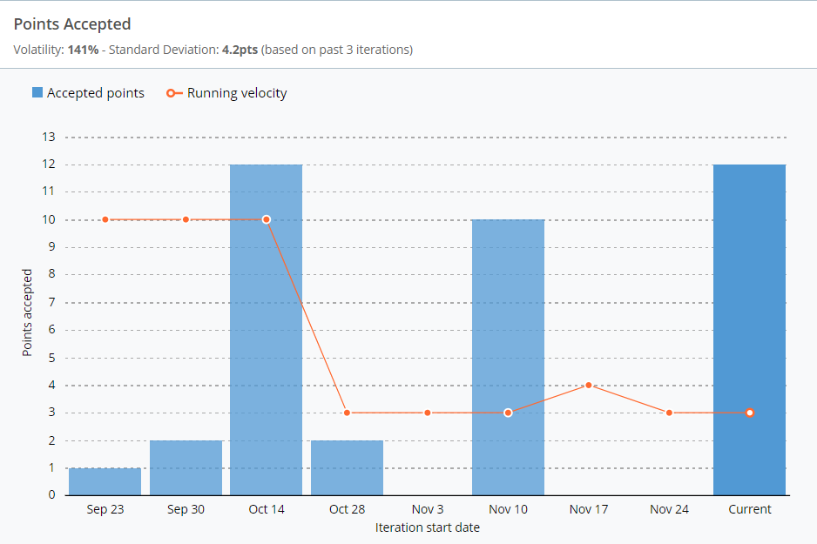

Slide 8
Software Design

Slide 9
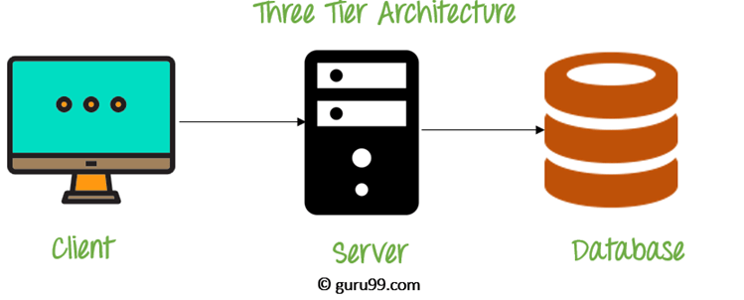
Site Architecture
Site Architecture - 3 Tier Architecture
1. Presentation layer (Client Browser):
a. HTML using aspx pages
b. Java Script
c. Jquery
d. Css
2. Application Layer
a. ASP.NET,C# using aspx.cs pages
b. Communicates to presentation layer via URL Querying
3. Data Layer
a. Sql server. Receives commands from Application Layer.
Notes:
J

Slide 10
Classes and Methods
StudentLogged
Self Project List
Edit
Delete
Log Out
StudentProfile
Edit Profile
AddProject
Only student adds project
FacultyLogged
All Projects
Edit
Delete
Log Out
FacultyProfile
Edit Profile
StudentList
Faculty list of projects
Home
Login
Forgot PW
Registration
Signup
ProjectList
View all projects
Search
View one Project
Comment on that one project

Slide 11
Design Pattern - The Facade - Take 2
The front end “Facade” is the project list
This one class should be the outward appearance. Everytime we need to display the list, we will use this one class project list.
From the project list, the class will look at student class, faculty class, search class.
Benefits:
One batch of code, the outward appearance of the project list, aka the Facade, can be thrown into any situation.
Examples
As a student, I can add a professor to be a sponsor, but the professor cannot add a student as a Sponsor. The Facade is that a project is a project, but in reality there are student projects and professor views and interactions on that project. So the project list needs to be the facade, looking at sub systems to determine student/professor data.
Reality:
Have multiple lists on multiple pages, code scattered and duplicated. Currently we have duplicated code at:
FacultyLogged
ProjectList
StudentList
StudentLogged
Desire with this design:
One module to display project list no matter the context.

Slide 12
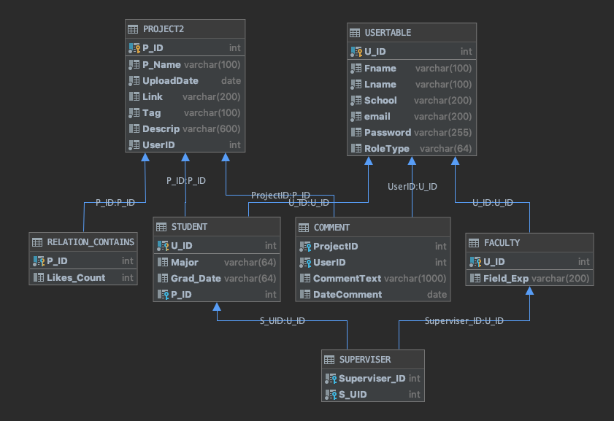
DESIGN ARCHITECTURE
DB Architecture fully implemented in MS SQL Server
Developed and implemented constraints to avoid data anomalies
Sample tuples created to display functionality
Pending SQL Unit Testing with tuples
Notes:
J

Slide 13
Implementation

Slide 14
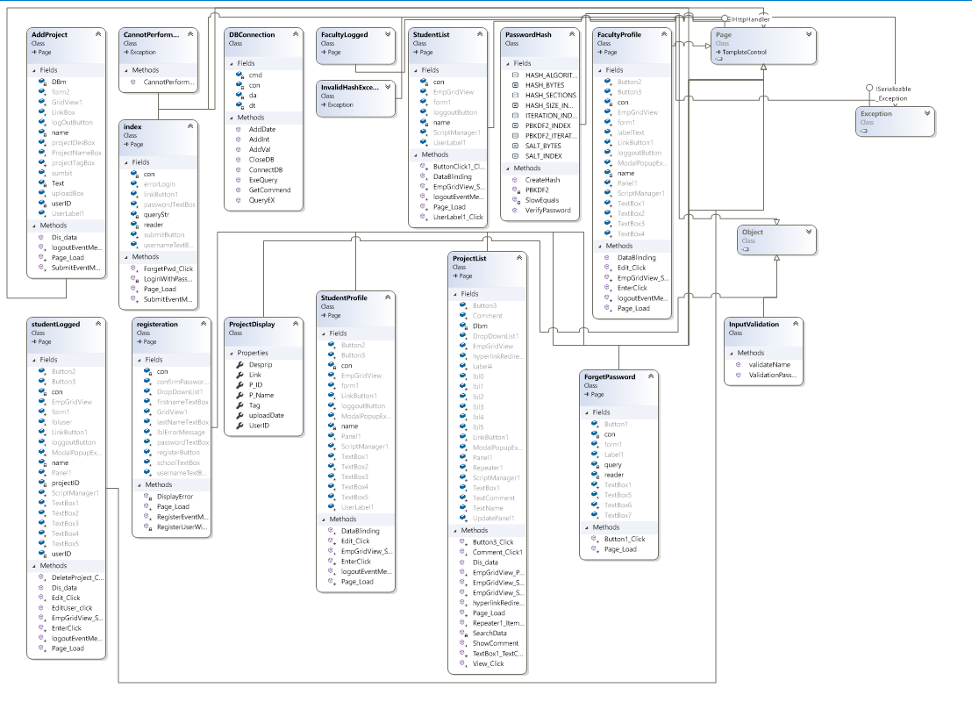
Project Structure
Generated via Visual Studio

Slide 15
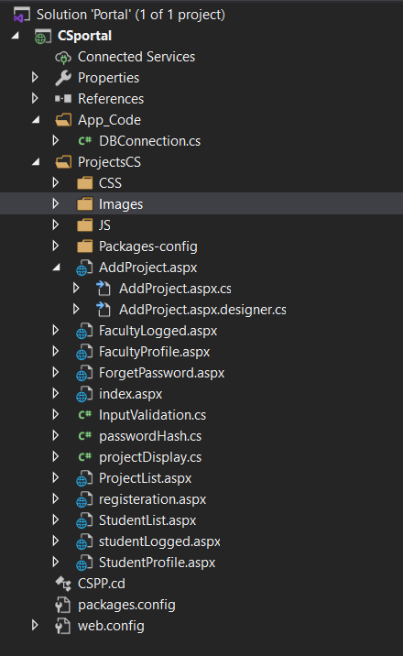
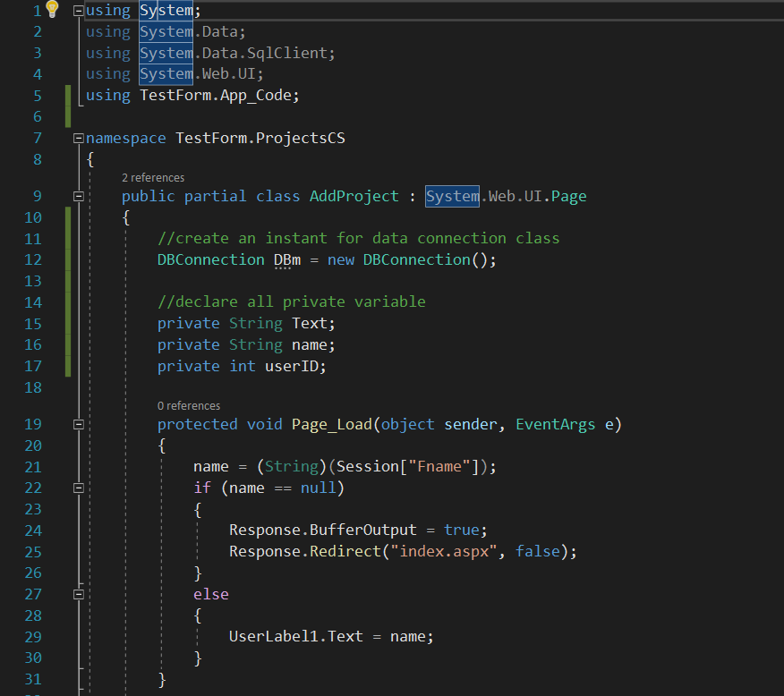
Code Sample WebForm ASP.Net

Slide 16
Refactoring
What We Should Do
Avoid code smell (esp duplicate code)
Refactoring when keep writing the same code more than 3 times.
Code Reuse
More testing
More code review

Slide 17
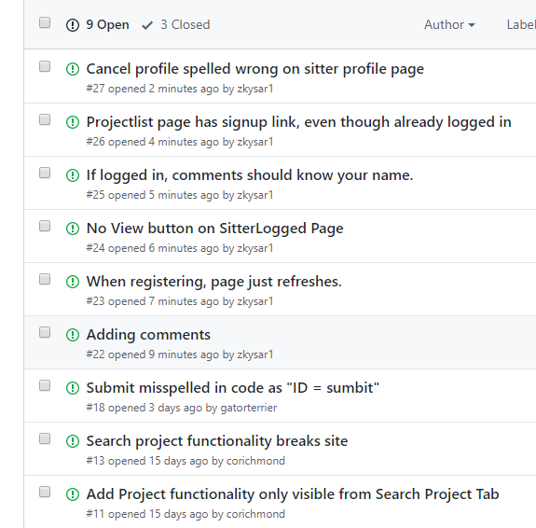
Tracking issues with Git

Slide 18
Two Environments
http://www.computerscienceprojectportal.com/
http://test.computerscienceprojectportal.com/

Slide 19
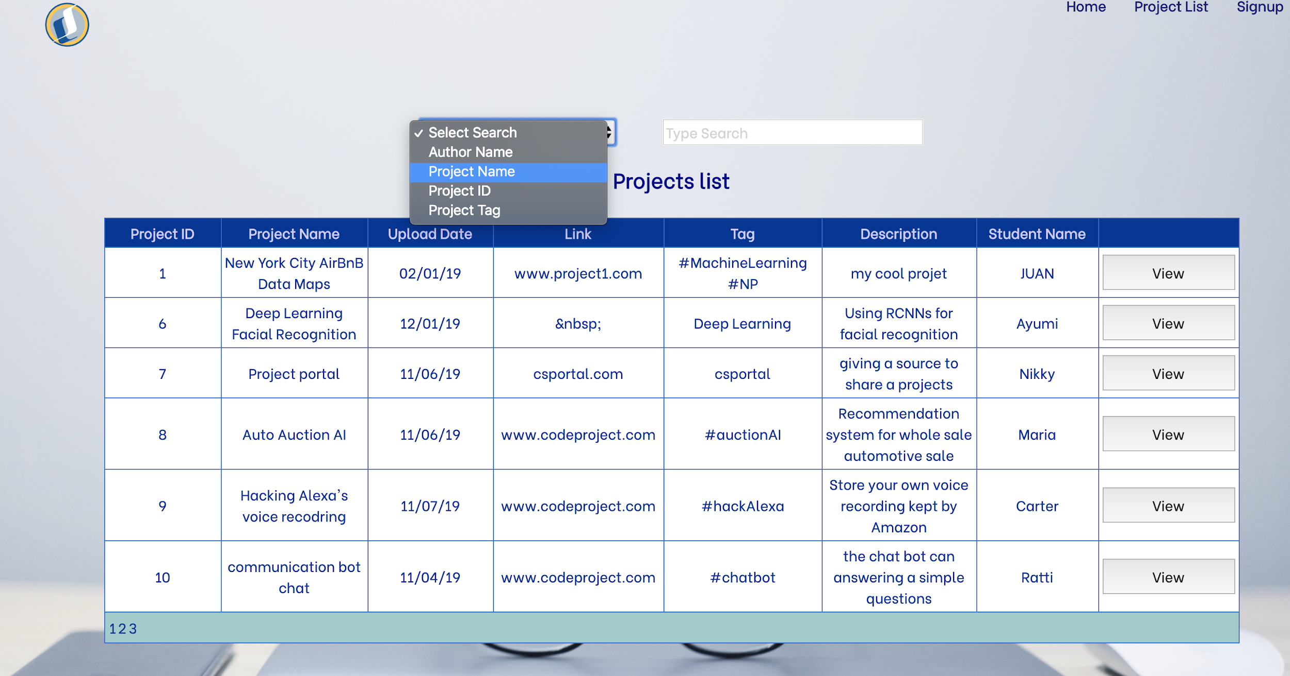
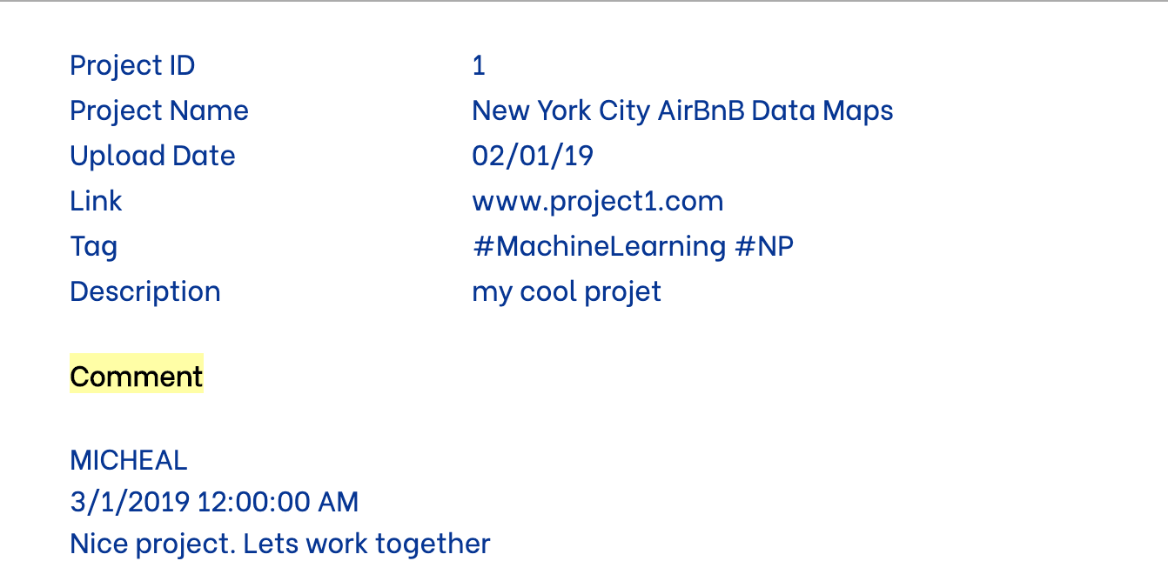
Front End
Built Search functionality into Project list page
Users can view all hosted projects
In the View Project popup users can add comments for the project author to see

Slide 20
Struggling is Real
Not know the platform very well
Limited knowledge in a language used.
The Webform platform already inheritance via system web UI
Old System, not very flexible.
Time consuming to do the right way
WHAT IF I KNOW
MVC for sure, more flexible and more community support, code sample
Design beforehand before things mess around

Slide 21
Security

Slide 22
Security Achievement (CIA)
Confidentiality:
The system authorized only a user who have username and password to login into the system.
Integrity:
Only Student can modified their own project.
Only Faculty can view email their supervisees.
Faculty and Student can edit their own profile.
Availability:
All users can view all projects
All users can search projects.

Slide 23
OWASP Secure Coding
What we Should Do:
Remove all possibility bad smells
Input validation every pages
Error handling
Partitioning large classes
Hiding sensitive date
Enforce password complexity

Slide 24
Testing

Slide 25
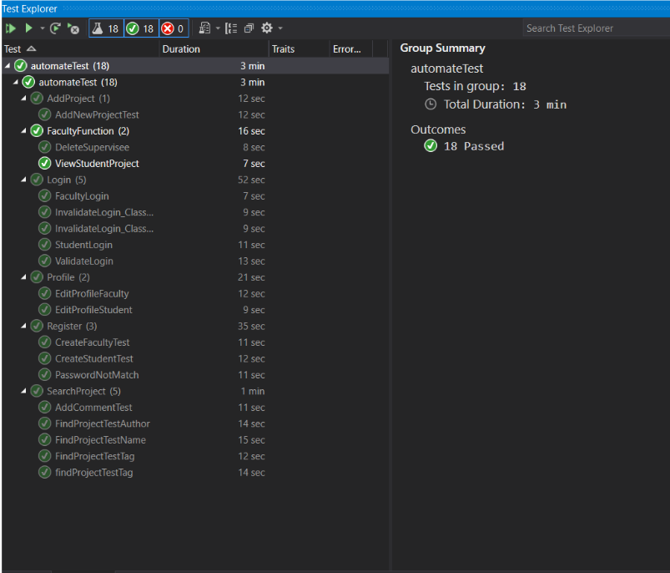
Testing
Implemented automated testing and ran test cases using Visual Studio (C#) and Selenium.
Categories:
Add Project
Faculty Function
Login
Profile
Register
Search Project
Test Metrics
Test Case Pass Rate = 18 / 18
Defect Density = 9 / 2089
Test Case Pass Rate

Slide 26
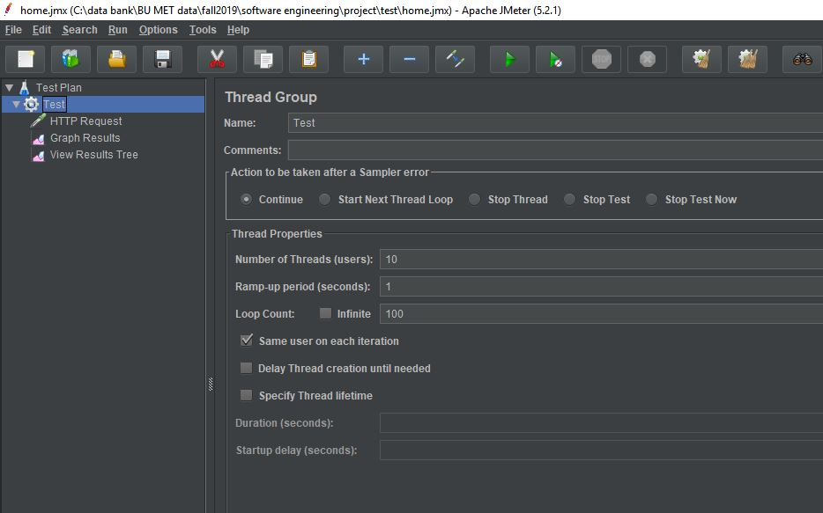
Performance Testing

Slide 27
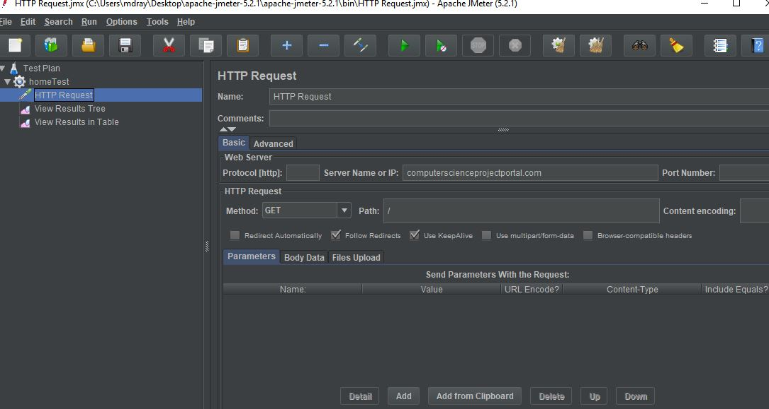
Login performance

Slide 28
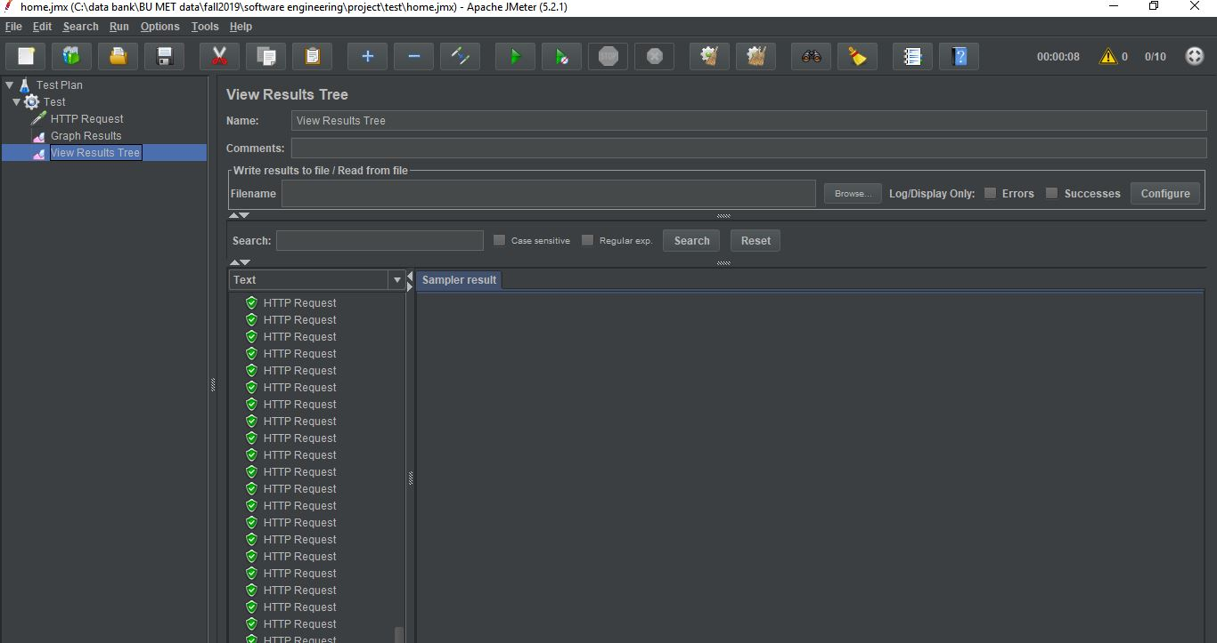
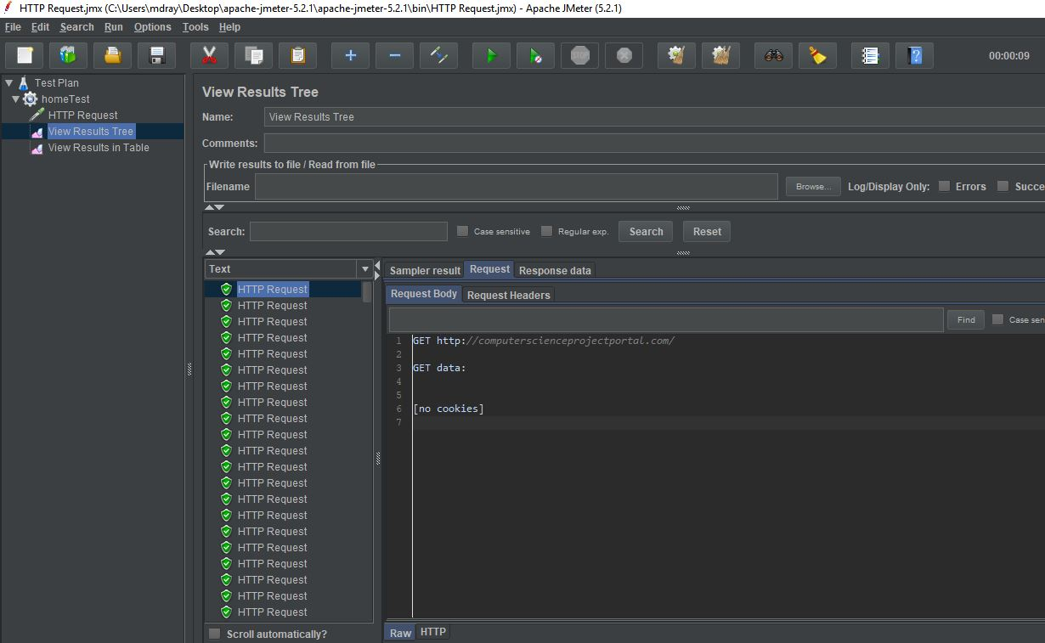
Login performance

Slide 29
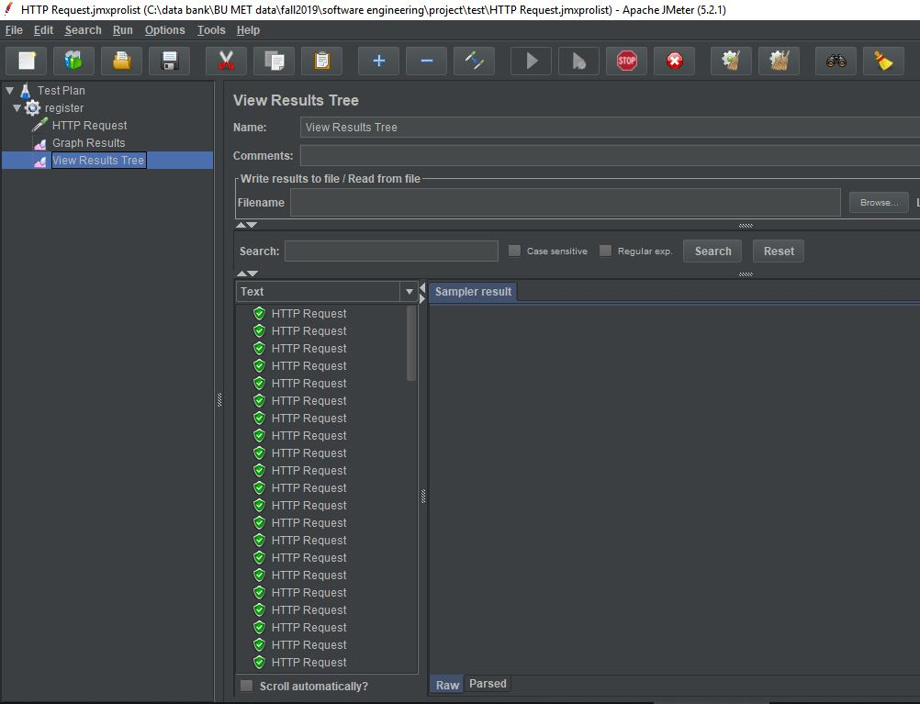
Register request

Slide 30
Project Management

Slide 31
Team Structure
Team Member | Formal Roles | Key Contributions
Zachary Kysar | Backup Team Leader and Requirements Leader | Major Site Developer, Design and Planning, Risk Analysis and Mitigation
Connor Richmond | Team Lead | Documentation Management, Github Management, Risk Analysis and Mitigation
Juan P Sanchez | Quality Lead | Database Design and Implementation, Test Case Design and Implementation, Metric Tracking
Rattikan Dudley | Security Lead | Lead Software Developer, Implement Security Protocols, Huge driver of all changes on site. Our Software SME :)
Molla Negash | Configuration Management Plan Lead | Testing

Slide 32
Development Lifecycle + Risk Management
Document + Refine
Document all iteration improvements. Refine development process as appropriate
Iteration Planning
Discuss what we plan to accomplish this iteration as a team
Iteration Development
Test + Modify
Manually test and build test cases for software robustness. Adapt code if tests fail.
Risk Identification
What could go wrong this iteration? How do we mitigate those risks?
Development + Implementation
Work towards goals for this iteration. Flag any changes to risk likelihood

Slide 33
Key Learnings
What Worked
Consistent communication via slack and video conference
Dividing up work with clear deliverables
User story tracking with pivotal tracker
Shifting site design from cshtml to aspx
Enhanced site design and user experience
Automated test cases with C#
Recurring meetings
What We’d Change
Software design and architecture should have been more up front
Consistent use of IDEs to mitigate version control misshapes in version control
Planning iteration progress more around requirements from day 1
Tighter version control policies, and more transparent handlings conflicts

Slide 34
Future Work
First step would be implementing a full test suite
Build out new functionality from list of desired/optional requirements
Upload files to project
Look for Contributor functionality
Send projects to other users (probably over email)
Add additional security measures
Switch to Google OAuth instead of hashing passwords
Add measures to prevent SQL injections when creating account or adding projects
Further iterate on UI to create an improved user experience

Slide 35
Demo

